Slide 1
GEOG 392/676 GIS Programing Lab2
Zhenlei Song, Ph.D Student
Department of Geography
Email: songzl@tamu.edu
Office: CSA 301F

Slide 2
Lab 2 Tasks
Loops in Python
Conditional Statements in Python
Tools

Slide 3
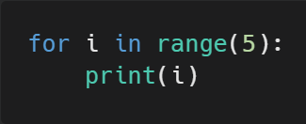
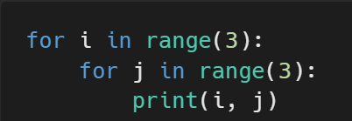
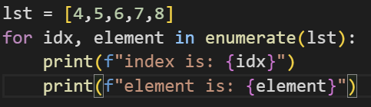
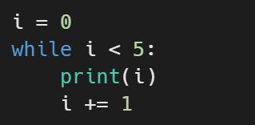
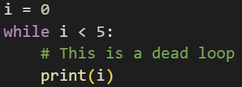
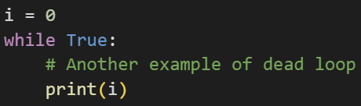
Loops
For Loops
While Loops
Be Careful with Dead Loops

Slide 4
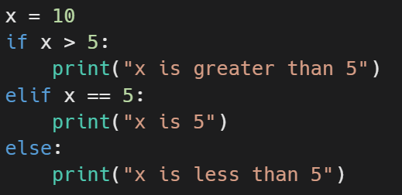
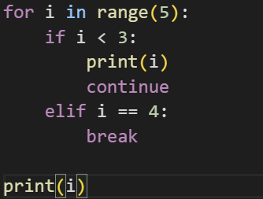
Conditionals (if/elif/else)
if/elif/else
Loop control with if/else

Slide 5
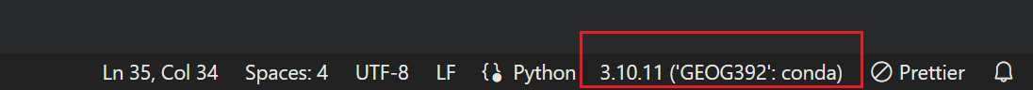
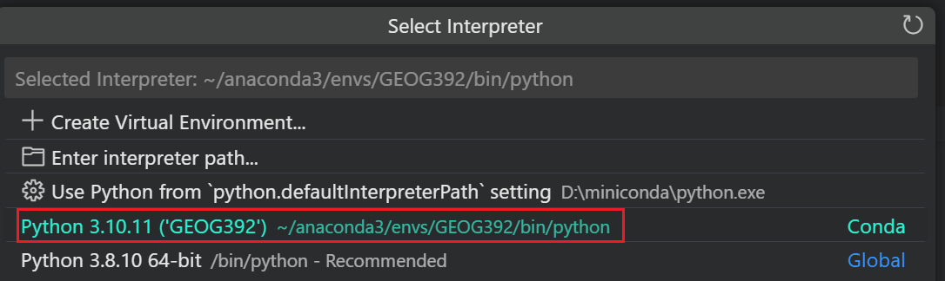
Debugging using VSCode
Select Python Interpreter

Slide 6
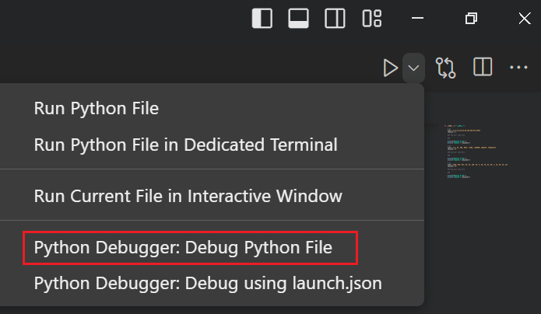
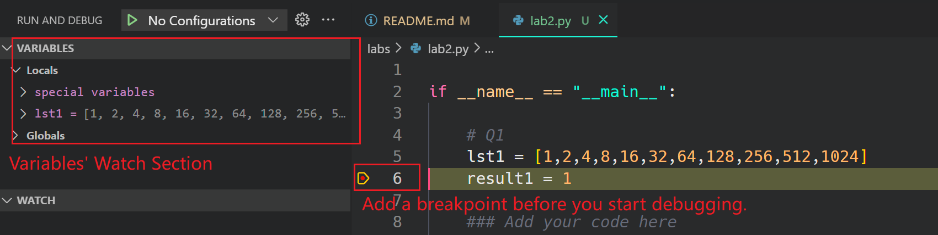
Debugging using VSCode
Start Debugger

Slide 7
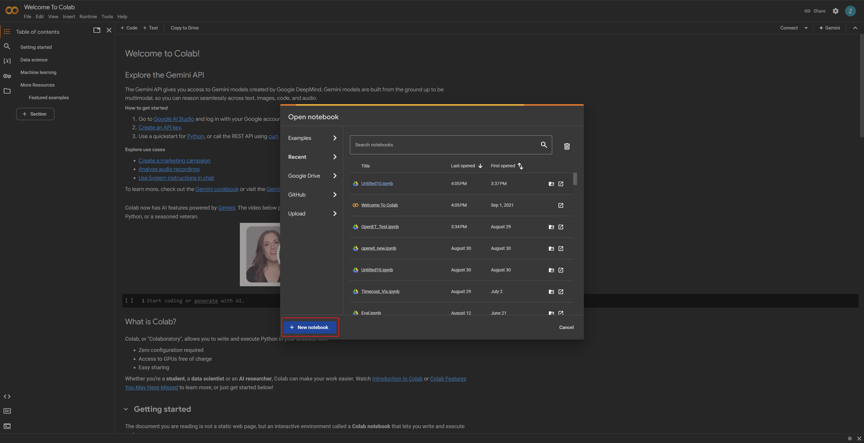
Colab as a playground
Start Google Colab
https://colab.research.google.com/

Slide 8
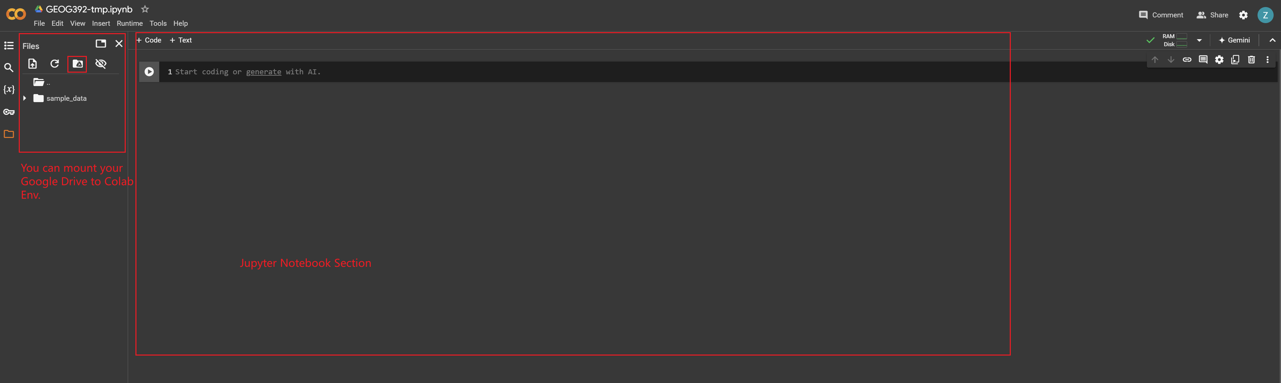
Colab as a playground
Colab Features
A Jupyter Notebook env with pre-installed python packages
Able to mount Google Drive, to load files into Colab env

Slide 9
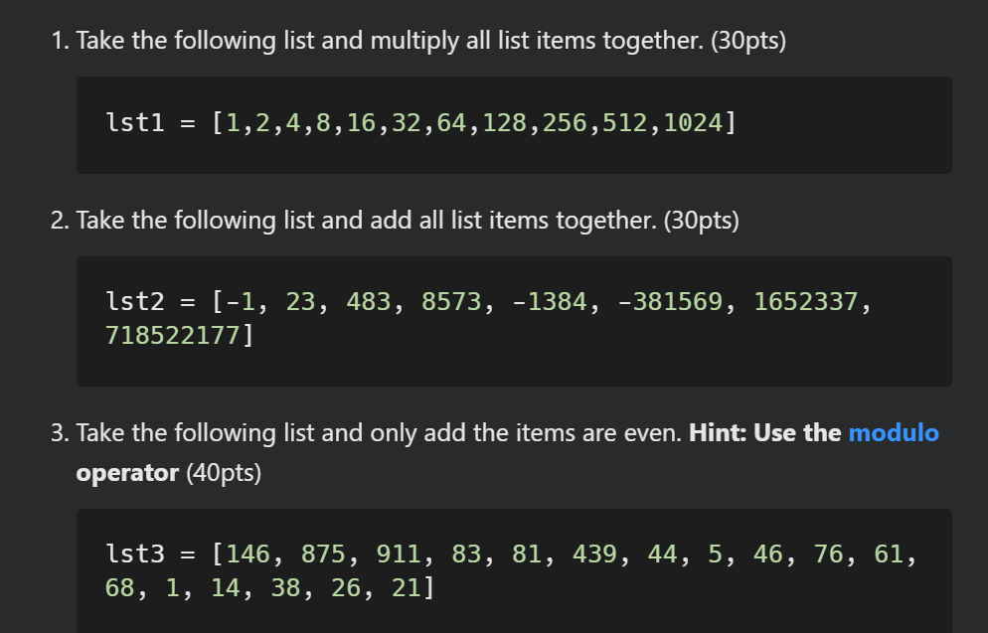
Assignment Questions

Slide 10
Submission
Submit a PDF file includes:
Screenshots of all your codes
Screenshots of the running results
Link to your Github Repo

Slide 11

Additional Resources
Useful Links
Python Operators
W3School Python Tutorial
VS Code Debugging
Colab Docs
VS Code Plugins
Python
Pylance
Python Debugger
Gitlens

Slide 12
The End

